Slide 1
Blacktown Chinese Christian Church
Welcome to Our English Service 12.01.2025
English Service 9:45 – 11:00 am
Worship Songs: Passage: Speaker: Topic: Response Song: Announcements and Closing Prayer Benediction
Living Hope Lighthouse Yet Not I But Through Christ In Me 1 Thessalonians 4:1-18 TBA TBA TBA

Slide 2
BCCC english service

Slide 3

Please keep all phones on silent

Slide 4
Living Hope
Brian Johnson, Phil Wickham © 2017 Phil Wickham Music (Admin. by Crossroad Distributors Pty. Ltd.) Simply Global Songs (Admin. by Crossroad Distributors Pty. Ltd.) Sing My Songs (Admin. by Crossroad Distributors Pty. Ltd.) Bethel Music Publishing (Admin. by SHOUT! Music Publishing Australia) CCLI Licence No. 5485849. CCLI Song number: 7106807

Slide 5
Verse 1
How great the chasm that lay between us
How high the mountain I could not climb
In desperation, I turned to heaven
And spoke Your name into the night

Slide 6
Verse 1
Then through the darkness, Your loving kindness
Tore through the shadows of my soul
The work is ﬁnished, the end is written
Jesus Christ, my living hope

Slide 7
Verse 2
Who could imagine so great a mercy?
What heart could fathom such boundless grace?
The God of ages stepped down from glory
To wear my sin and bear my shame

Slide 8
Verse 2
The cross has spoken, I am forgiven
The King of Kings calls me His own
Beautiful Savior, I'm Yours forever
Jesus Christ, my living hope

Slide 9
Chorus
Hallelujah, praise the One who set me free
Hallelujah, death has lost its grip on me

Slide 10
Chorus
You have broken every chain
There's salvation in Your name
Jesus Christ, my living hope

Slide 11
Chorus
Hallelujah, praise the One who set me free
Hallelujah, death has lost its grip on me

Slide 12
Chorus
You have broken every chain
There's salvation in Your name
Jesus Christ, my living hope

Slide 13
Verse 3
Then came the morning that sealed the promise
Your buried body began to breathe
Out of the silence, the Roaring Lion
Declared the grave has no claim on me (x2)

Slide 14
Verse 3
Jesus, Yours is the victory

Slide 15
Chorus
Hallelujah, praise the One who set me free
Hallelujah, death has lost its grip on me

Slide 16
Chorus
You have broken every chain
There's salvation in Your name
Jesus Christ, my living hope

Slide 17
Outro
Hallelujah, praise the One who set me free
Hallelujah, death has lost its grip on me

Slide 18
Outro
You have broken every chain
There's salvation in Your name
Jesus Christ, my living hope

Slide 19
Tag
Jesus Christ, my living hope
Oh God, You are my living hope

Slide 20
My Lighthouse
Chris Llewellyn, Gareth Gilkeson © 2013 Thankyou Music (Admin. by SHOUT! Music Publishing Australia) CCLI Licence No. 5485849 . CCLI Song number: 7002032

Slide 21
Verse 1
In my wrestling and in my doubts
In my failures You won't walk out

Slide 22
Verse 1
Your great love will lead me through
You are the peace in my troubled sea
You are the peace in my troubled sea

Slide 23
Verse 2
In the silence, You won't let go
In my questions, Your truth will hold

Slide 24
Verse 2
Your great love will lead me through
You are the peace in my troubled sea
You are the peace in my troubled sea

Slide 25
Chorus
My lighthouse
My lighthouse
Shining in the darkness
I will follow You

Slide 26
Chorus
My lighthouse
My lighthouse
I will trust the promise
You will carry me safe to shore

Slide 27
Chorus
Safe to shore
Safe to shore
Safe to shore

Slide 28
Verse 3
I won't fear what tomorrow brings
With each morning I'll rise and sing

Slide 29
Verse 3
My God's love will lead me through
You are the peace in my troubled sea
You are the peace in my troubled sea

Slide 30
Chorus
My lighthouse
My lighthouse
Shining in the darkness
I will follow You

Slide 31
Chorus
My lighthouse
My lighthouse
I will trust the promise
You will carry me safe to shore

Slide 32
Chorus
Safe to shore
Safe to shore
Safe to shore

Slide 33
Bridge
Fire before us, You're the brightest
You will lead us through the storms (x4)

Slide 34
Chorus
My lighthouse
My lighthouse
Shining in the darkness
I will follow You

Slide 35
Chorus
My lighthouse
My lighthouse
I will trust the promise
You will carry me safe to shore

Slide 36
Chorus
Safe to shore
Safe to shore
Safe to shore

Slide 37
Yet Not I But Through Christ In Me
Jonny Robinson, Michael Farren, Rich Thompson ©2018 CityAlight Music (Admin. by Integrity Music) Farren Love And War Publishing (Admin. by Integrity Music) Integrity's Alleluia! Music (Admin. by Integrity Music) CCLI Licence No. 5485849. CCLI Song number: 7121852

Slide 38
Verse 1
What gift of grace is Jesus, my Redeemer
There is no more for heaven now to give
He is my joy, my righteousness and freedom
My steadfast love, my deep and boundless peace

Slide 39
Chorus 1
To this I hold, my hope is only Jesus
For my life is wholly bound to His
Oh how strange and divine, I can sing "All is mine"
Yet not I, but through Christ in me

Slide 40
Verse 2
The night is dark but I am not forsaken
For by my side, the Savior He will stay
I labour on in weakness and rejoicing
For in my need, His power is displayed

Slide 41
Chorus 2
To this I hold, my Shepherd will defend me
Through the deepest valley He will lead
Oh the night has been won and I shall overcome
Yet not I, but through Christ in me

Slide 42
Verse 3
No fate I dread, I know I am forgiven
The future sure, the price it has been paid
For Jesus bled and suffered for my pardon
And He was raised to overthrow the grave

Slide 43
Chorus 3
To this I hold, my sin has been defeated
Jesus now and ever is my plea
All the chains are released, I can sing "I am free"
Yet not I, but through Christ in me

Slide 44
Verse 4
With every breath, I long to follow Jesus
For He has said that He will bring me home
And day by day, I know He will renew me
Until I stand with joy before the throne

Slide 45
Chorus 4
To this I hold, my hope is only Jesus
All the glory evermore to Him
When the race is complete, still my lips shall repeat
"Yet not I, but through Christ in me"

Slide 46
Tag
When the race is complete, still my lips shall repeat
"Yet not I, but through Christ in me"
"Yet not I, but through Christ in me"
"Yet not I, but through Christ in me"

Slide 47

Bible reading

Slide 48
Bible reading: 1 Thessalonians 4:1-18
As for other matters, brothers and sisters, we instructed you how to live in order to please God, as in fact you are living. Now we ask you and urge you in the Lord Jesus to do this more and more. ² For you know what instructions we gave you by the authority of the Lord Jesus.

Slide 49
Bible reading: 1 Thessalonians 4:1-18
³ It is God’s will that you should be sanctified: that you should avoid sexual immorality; ⁴ that each of you should learn to control your own body in a way that is holy and honorable,

Slide 50
Bible reading: 1 Thessalonians 4:1-18
⁵ not in passionate lust like the pagans, who do not know God; ⁶ and that in this matter no one should wrong or take advantage of a brother or sister. The Lord will punish all those who commit such sins, as we told you and warned you before.

Slide 51
Bible reading: 1 Thessalonians 4:1-18
⁷ For God did not call us to be impure, but to live a holy life. ⁸ Therefore, anyone who rejects this instruction does not reject a human being but God, the very God who gives you his Holy Spirit.

Slide 52
Bible reading: 1 Thessalonians 4:1-18
⁹ Now about your love for one another we do not need to write to you, for you yourselves have been taught by God to love each other. ¹⁰ And in fact, you do love all of God’s family throughout Macedonia. Yet we urge you, brothers and sisters, to do so more and more,

Slide 53
Bible reading: 1 Thessalonians 4:1-18
¹¹ and to make it your ambition to lead a quiet life: You should mind your own business and work with your hands, just as we told you, ¹² so that your daily life may win the respect of outsiders and so that you will not be dependent on anybody.

Slide 54
Bible reading: 1 Thessalonians 4:1-18
¹³ Brothers and sisters, we do not want you to be uninformed about those who sleep in death, so that you do not grieve like the rest of mankind, who have no hope. ¹⁴ For we believe that Jesus died and rose again, and so we believe that God will bring with Jesus those who have fallen asleep in him.

Slide 55
Bible reading: 1 Thessalonians 4:1-18
¹⁵ According to the Lord’s word, we tell you that we who are still alive, who are left until the coming of the Lord, will certainly not precede those who have fallen asleep. ¹⁶ For the Lord himself will come down from heaven, with a loud command, with the voice of the archangel and with the trumpet call of God, and the dead in Christ will rise first.

Slide 56
Bible reading: 1 Thessalonians 4:1-18
¹⁷ After that, we who are still alive and are left will be caught up together with them in the clouds to meet the Lord in the air. And so we will be with the Lord forever. ¹⁸ Therefore encourage one another with these words.

Slide 57
Announcements

Slide 58





Account name: Blacktown Chinese Christian Church
Account number: 4216 50263
Offering
BSB: 112 - 879
Please put in "offering" as the reference
The offering box is available at the back of the hall

Slide 59
Prayer points

Slide 60
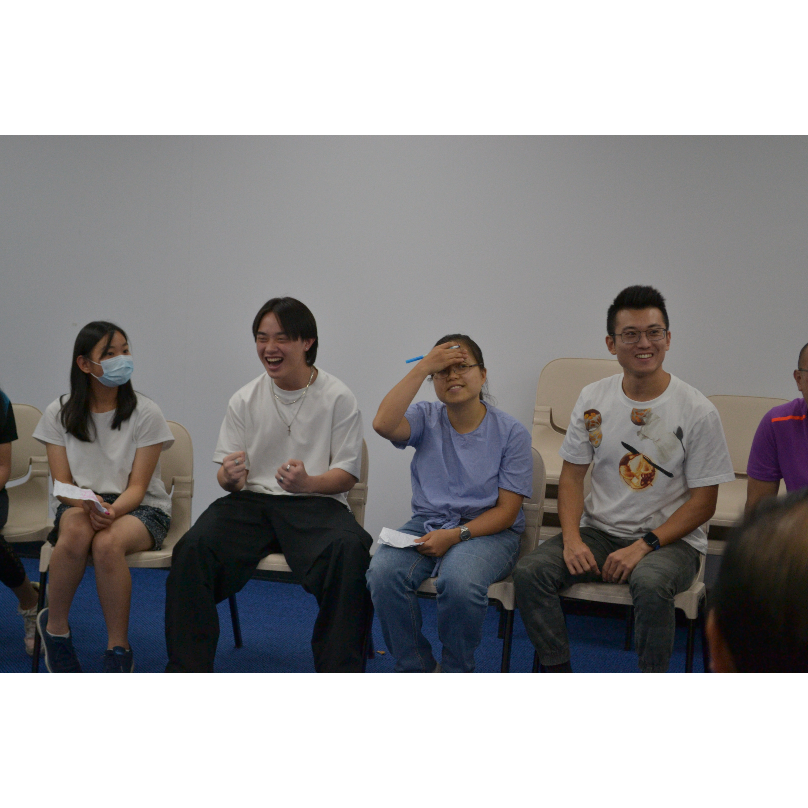
Mingle time!

